Slide 1

Study of Adequacy of Drainage in Urban Areas
Supervisor: Dr. A.K. Keshari Indian Institute of Technology, Delhi
Presented by: Mukul Anand

Slide 2
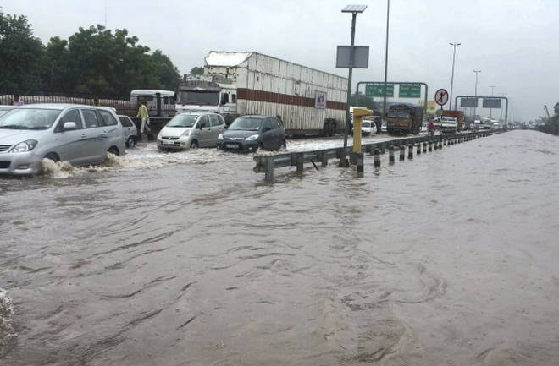
Introduction:
Urban flooding is not just “flooding that happens in an urban area.” This isn’t what happens when a river overflows its banks or when a hurricane drives a storm surge across a coastal neighbourhood. Instead, it’s caused by excessive runoff in developed areas where the water doesn’t have anywhere to go.
Urban flooding not only causes major property damage, it is also responsible for fatalities and injuries.
Urban drainage includes the removal of all unwanted water from urban areas.
Image source:https://www.thehindu.com/news/cities/Delhi/Flood-alert-in-Delhi/article16880748.ece

Slide 3
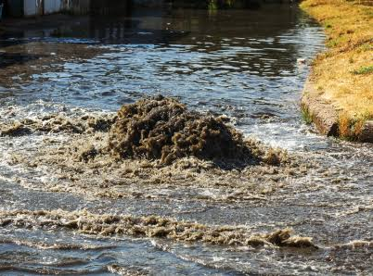
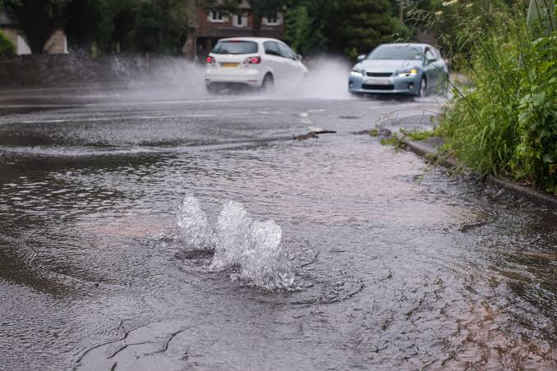
The common reason of urban flooding are :
Increase in impervious surfaces
Lack of proper drainage
Loss of wetlands
Less ground water usase/ recharge
Heavy precipitation
https://www.rytechinc.com/blog/why-sewage-flooding-in-your-home-is-a-ticking-time-bomb/
Image source:https://www.drainandsewer.co.uk/category/flooding/

Slide 4
Objective of the study
To estimate the design of drainage requirement in the urban areas using SWMM.
To find out the probable ways in which we can mitigate or reduce the problem of urban flooding.

Slide 5
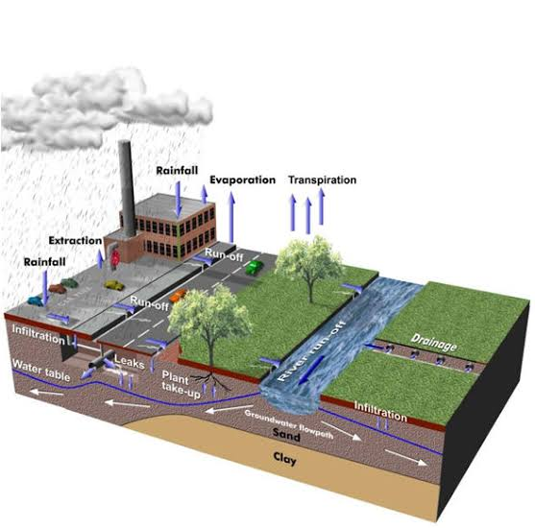
Methodology
Some of the common requirements of the drainage design are Rainfall data, Design storms, frequency of thunderstorms, Design Flow etc.
Available public domain software for are HEC-HMS for hydrologic modelling of the watershed, HEC-RAS for River modelling, SWMM(Storm Water Management Model) for sewer/ drainage design.
SWMM has been used for the purpose of study.
Image source: https://www.bgs.ac.uk/suds/

Slide 6
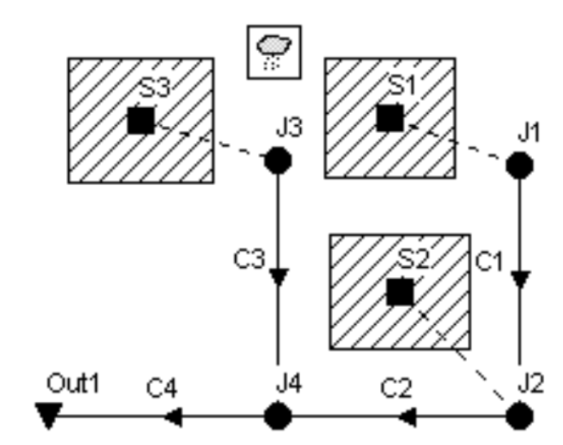
Model on SWMM:
Total residencial area= 12 acre
S1, S2, S3 = Subcatchments
C1, C2, C3, C4 = Storm Sewer Conduits
J1, J2, J3, J4 = Conduit junctions
Out1 = outlet
Area of each subcatchment is 4 acre
All the conduits has been chosen of Circular Geometry

Slide 7
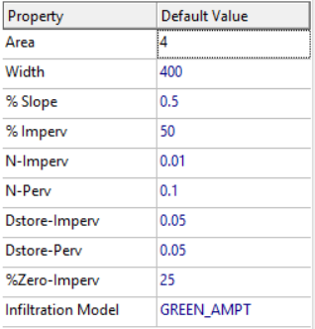
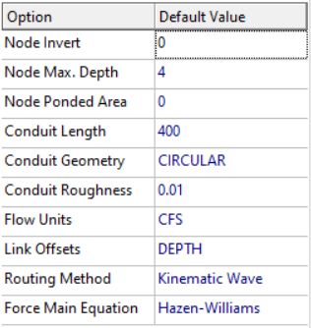
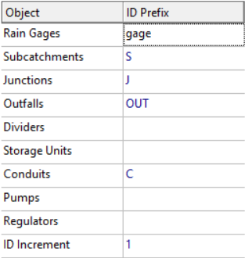
Project Defaults
Subcatchment Defaults
Nodes/links Defaults
Default ID lebels
Width is width of area where overland flow occurs

Slide 8
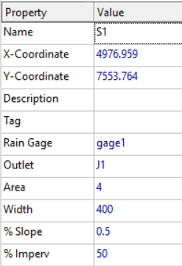
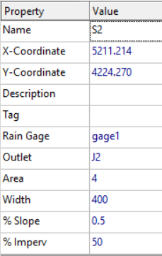
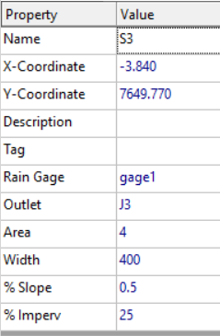
Subcatchment Properties
Node of the drainage system that receives runoff from the subcatchment needs to be setup. We are taking area S3(i.e subcatchment 3) as less developed than others for that we have assigned a % imperviousness of 25% to the subcatchment 3. Subcatchment width is the width of the area where overland flow occurs.
Subcatchment 1
Subcatchment 2
Subcatchment 3

Slide 9
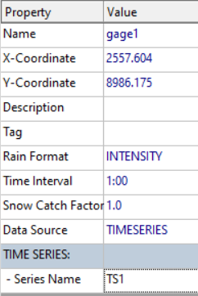
Invert level of Nodes
Rain Gage Properties
Node | Invert
J1 | 96
J2 | 90
J3 | 93
J4 | 88
Out1 | 85

Slide 10
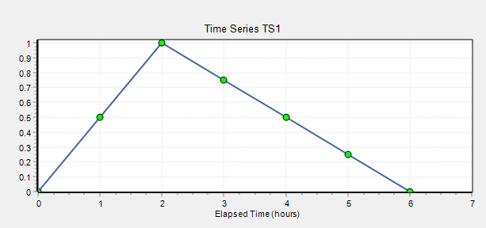
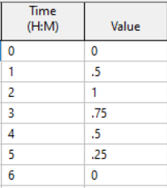
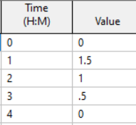
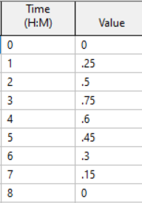
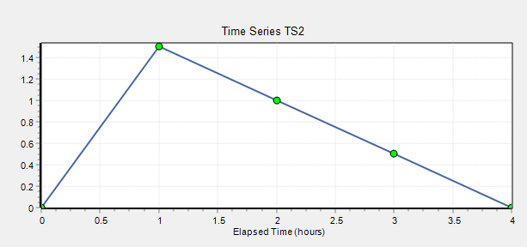
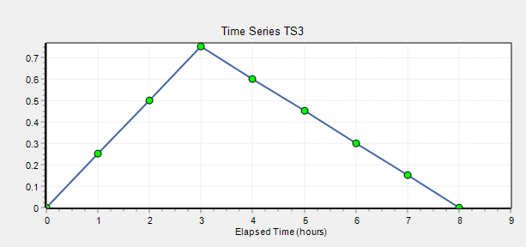
3 design storms whose timeseries are names as TS1, TS2 and T3 which are 3 inch-6 hour, 3 inch-4 hour and 3 inch-8 hour storms respectively.
Timeseries of TS1 for a storm of 3 inch-6 hour storm
Timeseries of TS2 for a storm of 3 inch-4 hour storm.
Timeseries of TS1 for a storm of 3 inch-8 hour storm

Slide 11
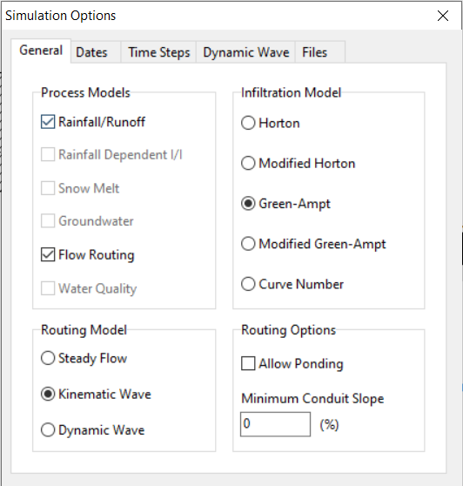
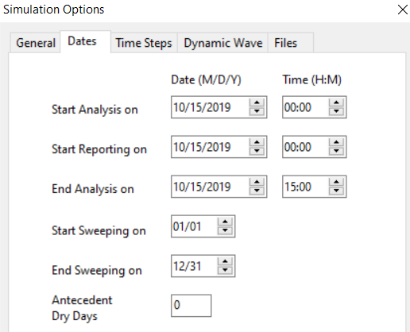
Running The Analysis
We will use Green-Ampt and Modified Green-Ampt Infiltration model for running the Analysis.

Slide 12
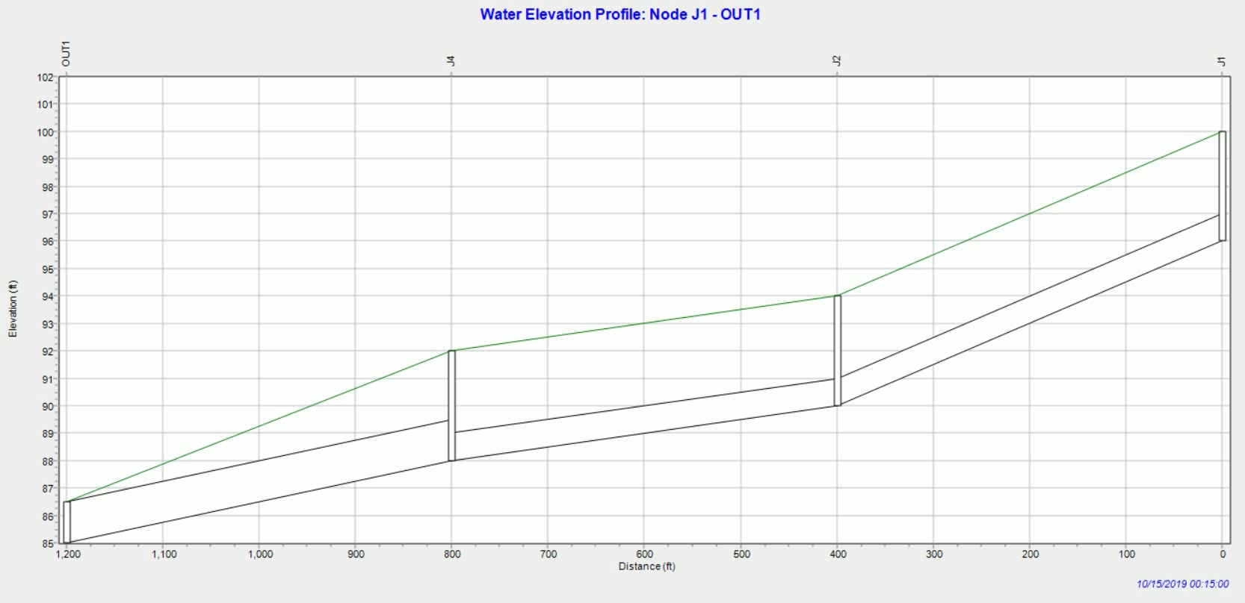
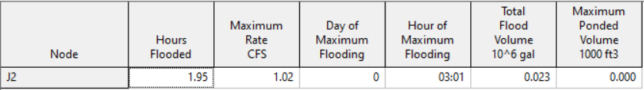
Results with Green-Ampt infiltration Model and TS1
Summary result of node flooding

Slide 13
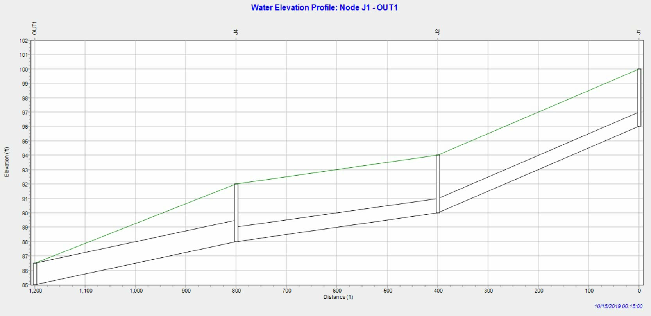
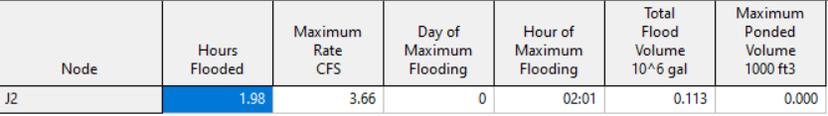
Results with Green-Ampt infiltration Model and TS2
summary result of node flooding

Slide 14
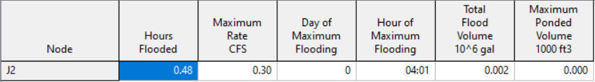
Results with Green-Ampt infiltration Model and TS3
summary result of node flooding

Slide 15
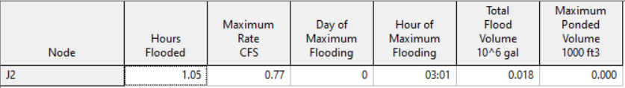
Results with Modified Green-Ampt infiltration Model and TS1
Summary result of node flooding

Slide 16
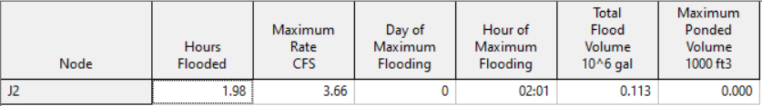
Results with Modified Green-Ampt infiltration Model and TS2
Summary result of node flooding

Slide 17
Results with Modified Green-Ampt infiltration Model and TS3
None of the Node got flooded.

Slide 18
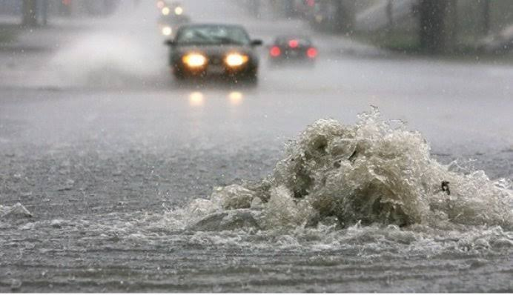
Node Flooding
Image source:https://emps.exeter.ac.uk/engineering/research/cws/research/urban-drainage/rapids.html

Slide 19
Mitigating Node Flooding
We can increase the diameter of conduits. However replacing the conduits of current drainage could cost a lot of money but that could encounter the losses occurring due to flooding due to inefficient drains. In our study also we have observed no cases of flooding on the path of J3 to OUT1. The reason for this is higher diameter of conduit 4.
We can keep a higher difference of invert levels so that the flow could be easier.
Keeping in mind the climatic changes the catchment treatment could be really better way to solve this. We need to promote afforestation which will be helpful in increasing the perviousness of the land resulting in low runoff and higher infiltration to the ground water. In this it would also be helpful for the ground water recharges. Also these days we are noticing a storms of higher intensity and lower duration which is the result of climatic changes. In the infiltration model of Modified Green-Ampt we observed that there is no flooding in case of 3 inch- 8 hour rainfall. Because the duration of rainfall is higher in this case and water is getting more time to infiltrate and drains are getting more time to drain out the water and also less inflow. Afforestation could be help with all these matter.

Slide 20
Referance
http://www.switchurbanwater.eu/outputs/pdfs/W2-2_GEN_PAP_Challenges_of_sustainable_urban_drainage_in_developing_countries.pdf
https://www.nrdc.org/experts/anna-weber/what-urban-flooding
https://www.tandfonline.com/doi/full/10.1080/15730620701464224
https://cdr.umd.edu/sites/cdr.umd.edu/files/resource_documents/COMPRESSEDurban-flooding-report-online-compressed-0319.pdf
https://link.springer.com/chapter/10.1007/978-3-319-56091-5_8
https://www.hec.usace.army.mil/software/hec-hms/
https://www.researchgate.net/publication/228327252_Sustainable_Urban_Drainage_Systems_-_A_possible_solution_to_the_problems_of_Flash_Floods_in_New_Delhi_India
https://iwaponline.com/wst/article/72/2/165/14899/Urban-drainage-system-planning-and-design
https://www.researchgate.net/publication/326441140_Urban_Floods_in_India

